Slide 1


It’s okay to say ‘NO’
Angel N. Moschel
Ivy Tech Community College
Fort Wayne Teaching & Learning Conference
February 16TH, 2024

Slide 2
Introduction
The costs of saying YES
fomo
saying No
The rrupp method
Wording your no
in positive ways

Slide 3
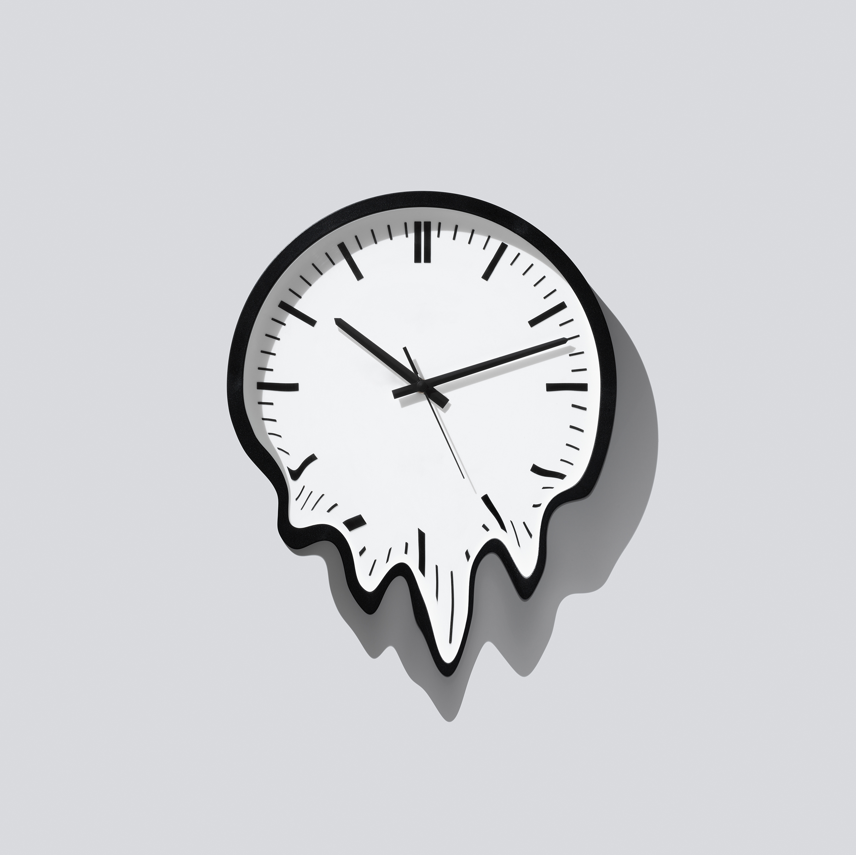
Costs of saying ‘YES’

Slide 4

Emotional Costs
“Saying ‘no’ is not a well-developed skill.” – Dr. Scott Bea
Reasons we say ‘yes’:
Avoid confrontation and “icky feelings”
FOMO
Please others (desire for approval)
Compulsivity
Not recognizing saying ‘yes’ can have negative consequences
Saying ‘YES’ too often can lead to feelings of anger and resentment, lashing out at others or internally, which then effects our self-esteem and relationships.

Slide 5

Mental Costs
Burnout: “The accumulation of responses to extended stressors caused by one’s job; characteristics of burnout are emotional exhaustion, cynicism (depersonalization), and low levels of self-efficacy” (Maslach and Jackson 1981; Maslach Scale)
2020 Gallop Poll: 44% of teachers in K-12 education said they very often or always feel burned out at work, while for college or university teachers, the figure was 35%. (Marken and Agrawal, 2022)
People who have trouble saying ‘no’ reported being more anxious and having “less sense of autonomy” in their lives.
Many reported feelings of lower self-esteem and “being less clear on their own priorities in life”. (Forbes 2017).

Slide 6

Physical Costs
Saying ‘YES’ to everything can create chronic stress: responsibilities start to stack up one on top of another, and chronic stress can lead to physical symptoms (Schaufeli, et al 2020).
Heart palpitations / chest pain
Stomach / intestinal / digestive issues
Rashes/ Hives
Pain: head, neck, shoulder, back etc
Flu-like symptoms
Fatigue
Sleep disturbances
Weight gain / Weight loss
Long-term effects can include heart disease, high-blood pressure, heart attacks, stroke, and easier risk of developing illness…these risks increase with age. (Mayo Clinic 2023).

Slide 7

Opportunistic Costs
Every ‘yes’ carries an opportunity cost = something else you could be doing instead. (Duncan 2022)
Instead of thinking about what you want to say ‘no’ to, think about what you want to say ‘yes’ to:
  Will this ‘yes’ be purposely productive, or will is be busy-work?
  Do I value this yes and how much of my time it will take?
  Will this ‘yes’ be a meaningful addition to my life?
  How much value will the ‘yes’ bring?
  Will the costs outweigh the value?
  Am I controlling the events in my life, or are others doing it for me through a series of ‘yeses’?

Slide 8
Knowing the right balance between being open to new experiences and taking care of your individual needs is highly specific for each person.
In other words, Its not the “what” you are agreeing to, it is the “how much” you are agreeing to…its all about time.

Slide 9
Saying ‘No’ & sticking to it – Foundations
Respect
Respect and appreciate your own use of time.
Recognize
Recognize your instincts and emotions: Don’t jump to say ‘yes’ out of habit or to avoid negative feelings.
Pre-empt
Pre-empt requests before they happen if possible.
Pause
Take time before saying ‘no’.
“I need to think about it” is an authentic answer!
Understand
Understand your priorities: It’s all about knowing your long-term goals and what ‘yeses’ will get you there.

Slide 10
Wording your ‘No’ – Avoid Powerless Language
Don’t apologize! You do not have to be sorry for saying ‘No’.
Avoid language that undermines your message.
  Qualifiers: words that make a statement less certain; can weaken your message. Example: “I’m really busy right now.”
  Hedges: words that make you seem uncertain. Example: ”Maybe I can work it in, I’ll have to check”.
  Disclaimers: words that disavow the sender from their own message. Example, “If it were up to me I’d say yes, but …”
  Self-effacing messages. Example: Oh, you don’t want me on that project, my ideas usually aren’t very good.
  Equivocal or relative terms: words that are ambiguous, vague; open to multiple interpretations. Example: I’ll let you know soon”.

Slide 11
Parts of an effective ‘No’
Include appreciation for being asked.
You can say ‘no’ while still recognizing the value in the project, the person, or the idea.
Be direct in your wording: you can be polite and assertive at the same time.
Have empathy: “It can be effective to acknowledge that you might be creating difficulty for the person by saying no.” (Bae 2020).
If applicable, include other resources in your ‘no’ that might help ‘lift the weight’ from the receiver.
If desired, include a reaffirming message that ‘keeps the door open’.
Saying ‘no’ to a supervisor: make sure to include an explanation or example of how saying ‘yes’ could actually lower your productivity. You may also opt to include a current list of projects, the timeframe needed, and ask them how they want you to prioritize them.

Slide 12

Let’s put it all together
I appreciate you thought of me for X. I really enjoyed working with you on [project]. Due to my schedule I have to say no at this time, but I’ll let you know if anything changes.
I know you are already doing Y and Z, and now you’ve taken on X too. That’s got to be stressful. Have you thought about asking [supervisor, leader, etc]?
While I can not do X now, I agree its important and I hope you’ll keep me in mind for future projects.
Practice saying ‘no’, it helps!

Slide 13
Practice ‘no’s
Since requests come randomly, it’s good to have a few variations of ‘no’ ready:
Thanks so much for the invite, but I’m really trying to focus on my X these days, so I’m going have to say no.
I actually have a lot on my plate right now, so I can’t help. Thanks for thinking of me, though, and I hope it works out.
I told myself I really have to go to the gym tonight. Actually, I’ve vowed to go to the gym consistently so I hit my New Year’s Resolution and I’d hate to break it—I hope you can understand.
Cecilia, it’s nice of you to think I would be capable of this and thanks for asking. My week is already scheduled out though. Unfortunately, I am going to have to decline.
I’m ready to take on [project] but I also have the X project deadline to meet. Which one should be my focus to finish by Friday afternoon?
Read more at: https://www.scienceofpeople.com/how-to-say-no/

Slide 14
Saying ‘No’ – Helpful Hints & Reminders
You are finite and so is your time – you can only stretch so far.
Don’t feel guilty for saying ‘no’.
You do not owe others detailed explanations for why you are saying ‘No’.
Be firm – If someone can’t accept your ’no’, don’t give in just to make them happy. Their emotional response to ‘no’ is not your responsibility.
Be selfish – its okay to put your needs before others.
Understand other people’s tactics (pressure, manipulation, etc) and prepare ahead!
Read more at: https://www.scienceofpeople.com/how-to-say-no/

Slide 15
Accepting NO…even when you don’t want to.
“We know when we ask a question that the chance of receiving the answer we want is like a roll of the dice. So, why is it difficult to accept no at various times?” (Smith 2022).
Emotive/ internal responses to the word itself – the ‘no’ may not be ‘all about you’.
Recognize that everyone has boundaries, and ‘no’ is an acceptable answer.
Understand your priorities are not the same as others. Neither is ‘comfortable workload’ ‘easy and quick’, or ‘pace of projects’.
Graciously accepting NO:
  Make eye contact and be aware of your nonverbals / facial expressions.
  Acknowledge the ‘no’
  Ask for a reason if you don’t understand the ‘no’
  Really listen to what’s being said. Don’t needle, shoot questions, or use pressure for a ‘yes’.

Slide 16
Final Thoughts
Being able to say ‘no’ is beneficial to our emotional, mental, and physical health.
Its okay to be selfish and put your own needs and goals before those of others.
Practice saying ‘no’ – it gets easier with time.
Remember how you use your time…and is how you are using it “sparking joy” in you?

Slide 17
Sources
Alpert, J. (2015). 7 Tips for saying no effectively. Excerpt from Be Fearless; Change your life in 28 days.
Babauta, L. (2022). The gentle art of saying no for a less stressful life. Zen Habits. Accessed 02/08/2023 from likehacks.org.
Bae, S. (2020). Save your sanity: Say no. Accessed 02/08/2023 from Cleveland Health Clinic website.
Bouchrika, I. (2023). Teacher burnout statistics: Challenges in K-12 and higher education. Retrieved 02/15/2023 from research.com.
Brown, C. (2023). The psychology of saying yes too much. Joint Chiropractic Mountain Brook.
Duncan, R.D. (2022). How to assess the opportunity cost of saying ‘yes’. Retrieved 02/08/2023 from Forbes Leadership & Careers online.
Marken, S., Agrawal, S. (2022). K-12 Workers Have Highest Burnout Rate in U.S. Gallup Poll. Retrieved 02/15/2023 from https://news.gallup.com
Maslach, C. and Jackson, S.E. (1981). The measurement of experienced burnout. J. Organiz. Behav., 2:99-113.
Mayo Clinic (2023). Chronic stress puts your health at risk. Accessed 02/17/2023 from https://www.mayoclinic.org/healthy-lifestyle/stress-management/in-depth/stress/art-20046037.
Schaufeli, W. B., Desart, S., & De Witte, H. (2020). Burnout Assessment Tool (BAT)-Development, Validity, and Reliability. International journal of environmental research and public health, 17(24), 9495.
Smith, C. (2022). How to accept no for an answer. Accessed 02/20/2023 from Etiquette for the business of life.
Van Edwards, V. ( 2023). 6 Effective tips to politely say no (that actually work!). Accessed 02/27/2023 from Science of People https://www.scienceofpeople.com/how-to-say-no/.

